Slide 1
Introduction to JVM ,JDK,JRE and ClassLoaders

Slide 2
Java Virtual machine
JVM (Java Virtual Machine) is an abstract machine. It is a specification that provides runtime environment in which java bytecode can be executed.
JVMs are available for many hardware and software platforms (i.e. JVM is platform independent).
What is JVM
A specification where working of Java Virtual Machine is specified. But implementation provider is independent to choose the algorithm. Its implementation has been provided by Oracle and other companies.
An implementation Its implementation is known as JRE (Java Runtime Environment).
Runtime Instance Whenever you write java command on the command prompt to run the java class, an instance of JVM is created.

Slide 3
What does JVM do
The JVM performs following operation:
Loads code
Verifies code
Executes code
Provides runtime environment
JVM provides definitions for the:
Memory area
Class file format
Register set
Garbage-collected heap
Fatal error reporting etc.

Slide 4
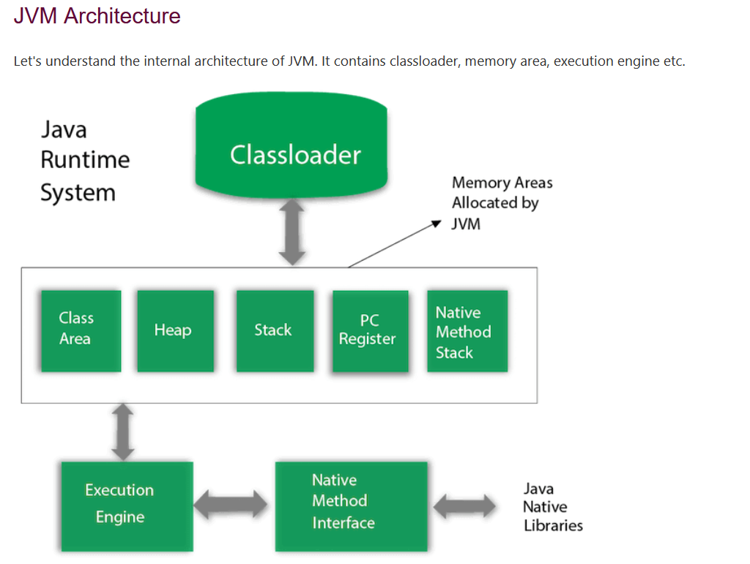
JVM architecture

Slide 5
ClassLoader
Classloader is a subsystem of JVM which is used to load class files. Whenever we run the java program, it is loaded first by the classloader. There are three built-in classloaders in Java.
Bootstrap ClassLoader: This is the first classloader which is the super class of Extension classloader. It loads the rt.jar file which contains all class files of Java Standard Edition like java.lang package classes, java.net package classes, java.util package classes, java.io package classes, java.sql package classes etc.
Extension ClassLoader: This is the child classloader of Bootstrap and parent classloader of System classloader. It loades the jar files located inside $JAVA_HOME/jre/lib/ext directory.
System/Application ClassLoader: This is the child classloader of Extension classloader. It loads the classfiles from classpath. By default, classpath is set to current directory. You can change the classpath using "-cp" or "-classpath" switch. It is also known as Application classloader.

Slide 6
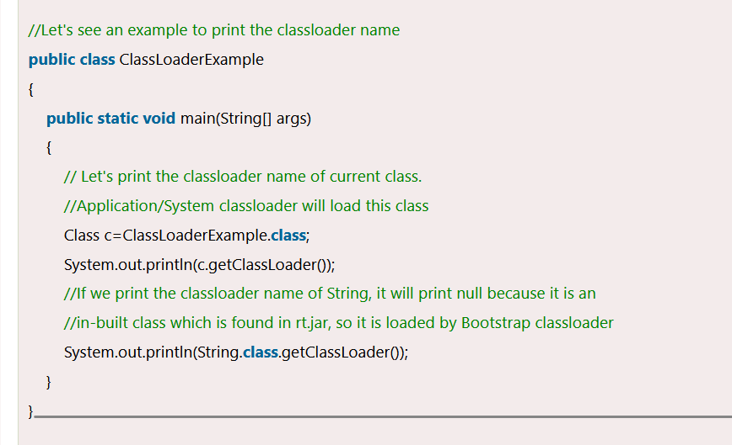
ClassLoader Example

Slide 7
Classloaders Examples
2) Class(Method) Area
Class(Method) Area stores per-class structures such as the runtime constant pool, field and method data, the code for methods.
3) Heap
It is the runtime data area in which objects are allocated.
4) Stack
Java Stack stores frames. It holds local variables and partial results, and plays a part in method invocation and return.

Slide 8
ClassLoader Types
Each thread has a private JVM stack, created at the same time as thread.
A new frame is created each time a method is invoked. A frame is destroyed when its method invocation completes.
5) Program Counter Register
PC (program counter) register contains the address of the Java virtual machine instruction currently being executed.
6) Native Method Stack
It contains all the native methods used in the application.
7) Execution Engine

Slide 9
Difference between JDK ,JRE and JVM
We must understand the differences between JDK, JRE, and JVM before proceeding further to Java. See the brief overview of JVM here.
If you want to get the detailed knowledge of Java Virtual Machine, move to the next page. Firstly, let's see the differences between the JDK, JRE, and JVM.

Slide 10
JVM
JVM (Java Virtual Machine) is an abstract machine. It is called a virtual machine because it doesn't physically exist. It is a specification that provides a runtime environment in which Java bytecode can be executed. It can also run those programs which are written in other languages and compiled to Java bytecode.
JVMs are available for many hardware and software platforms. JVM, JRE, and JDK are platform dependent because the configuration of each OS is different from each other. However, Java is platform independent. There are three notions of the JVM: specification, implementation, and instance.

Slide 11
JVM performs the following task
The JVM performs the following main tasks:
Loads code
Verifies code
Executes code
Provides runtime environment

Slide 12
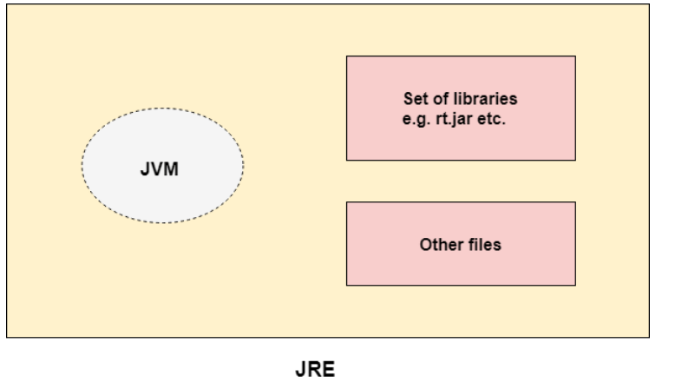
JRE
JRE is an acronym for Java Runtime Environment. It is also written as Java RTE. The Java Runtime Environment is a set of software tools which are used for developing Java applications. It is used to provide the runtime environment. It is the implementation of JVM. It physically exists. It contains a set of libraries + other files that JVM uses at runtime.
The implementation of JVM is also actively released by other companies besides Sun Micro Systems.

Slide 13
JDK
JDK is an acronym for Java Development Kit. The Java Development Kit (JDK) is a software development environment which is used to develop Java applications and applets. It physically exists. It contains JRE + development tools.
JDK is an implementation of any one of the below given Java Platforms released by Oracle Corporation:
Standard Edition Java Platform
Enterprise Edition Java Platform
Micro Edition Java Platform
The JDK contains a private Java Virtual Machine (JVM) and a few other resources such as an interpreter/loader (java), a compiler (javac), an archiver (jar), a documentation generator (Javadoc), etc. to complete the development of a Java Application.

Slide 14
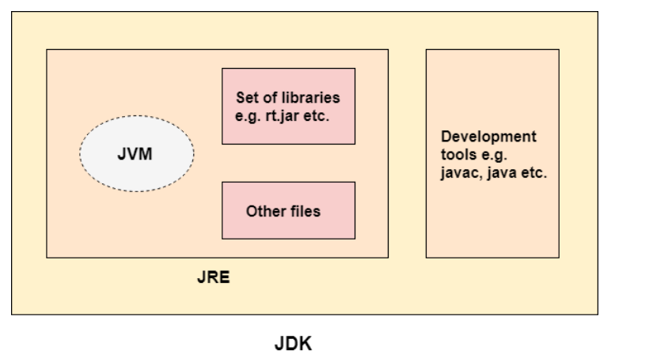
JDK Architecture

Slide 15
Most Popular JDKs
Oracle JDK: the most popular JDK and the main distributor of Java11,
OpenJDK: Ready for use: JDK 15, JDK 14, and JMC,
Azul Systems Zing: efficient and low latency JDK for Linux os,
Azul Systems: based Zulu brand for Linux, Windows, Mac OS X,
IBM J9 JDK: for AIX, Linux, Windows, and many other OS,
Amazon Corretto: the newest option with the no-cost build of OpenJDK and long-term support.

Slide 16
Naming Conventions in Java
Class: If you are naming any class then it should be a noun and so should be named as per the goal to be achieved in the program such as Add2Numbers, ReverseString, and so on not likely A1, Programming, etc. It should be specific pointing what exactly is there inside without glancing at the body of the class.
Interface: If you are naming an interface, it should look like an adjective such as consider the existing ones: Runnable, Serializable, etc. Try to use ‘able’ at the end, yes it is said to try as there are no hard and fast bound rules as if we do consider an inbuilt interface such as ‘Remote’, it is not having ble at the end. Consider if you are supposed to create an interface to make read operation then it is suggested as per naming conventions in java to name a similar likely ‘Readable’ interface.
Methods: Now if we do look closer a method is supposed to do something that it does contains in its body henceforth it should be a verb.
Constants: As the name suggests it should look like as we read it looks like it is fixed for examples PI, MAX_INT, MIN_INT, etc as follows.

